Slide 1
Photodetectors
Lecturer: Mauro Mosca
(www.dieet.unipa.it/tfl)
last update: 05/10/2021
University of Palermo – Master in Electronic Engineering

Slide 2
Overview
Thermal photodetectors
Photomultipliers
Responsivity and quantum efficiency
Spectral response
Detectivity
Time response
Photoconductors
p-n and p-i-n photodiodes
Phototransistors
Avalance PhotoDetectors (APD)
Charge-Coupled Devices (CCD)

Slide 3
Photodetector
Thermal
  Thermoelectric
  Bolometers
  Pyroelectric
Photonic
  Photomultipliers
  Photoconductors
  Photovoltaics
semiconductor-based

Slide 4
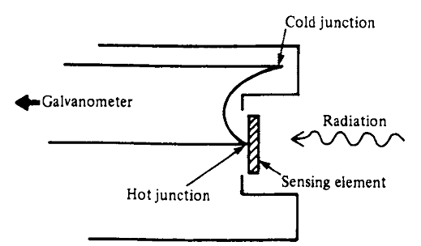
Thermoelectric detectors
- Principle of thermocouples
thermopile
large electrical
conductivities
small thermal
conductivities
minimize Joule
heating effects
minimize heat
conduction losses

Slide 5
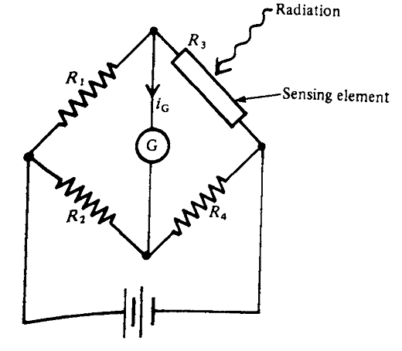
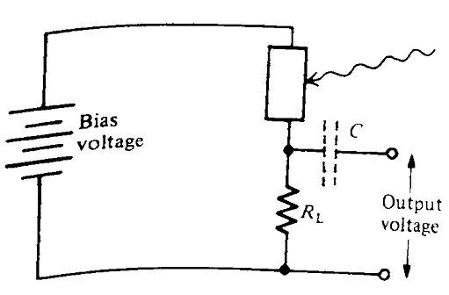
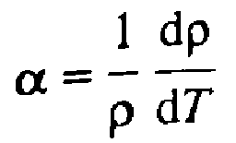

Bolometers
α_{Pt} ~ α_{Ni} =
= 0.005 K⁻¹
Sensing
element
current must not
raise temperature
too much
current flowing SMALL
Why?...

Slide 6
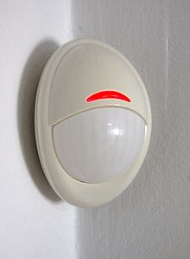
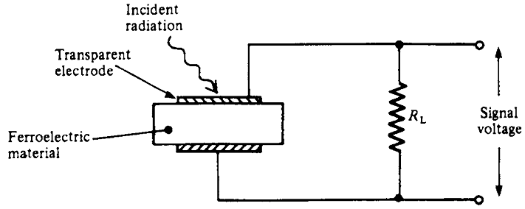
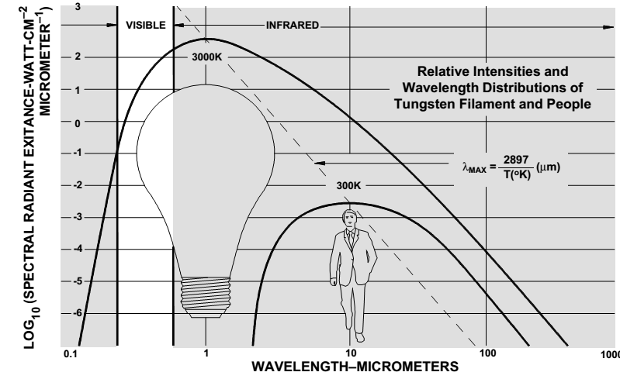
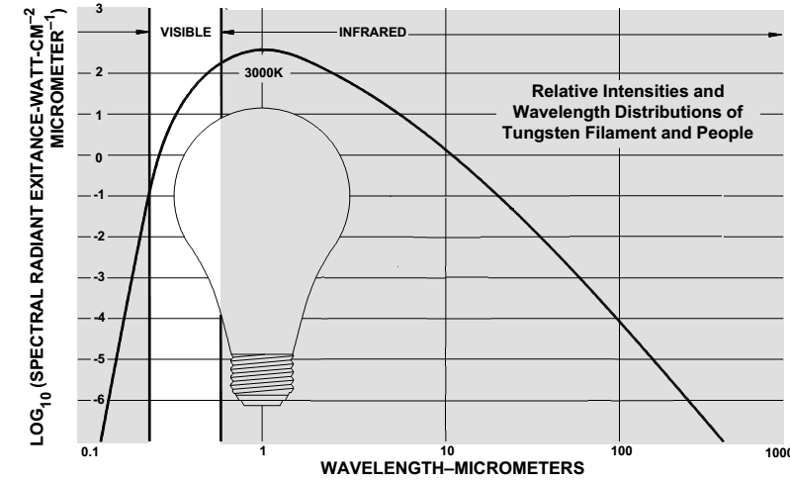
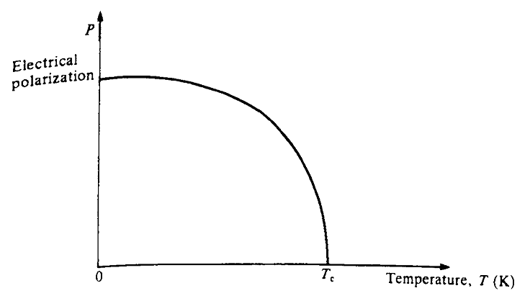
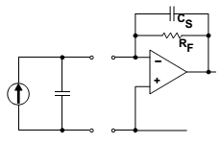
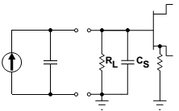

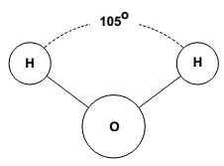
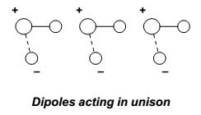
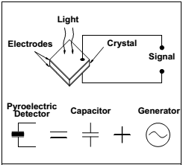

Pyroelectric detectors
PID = Passive Infrared Detectors
(motion sensors)
ferroelectric material
lead zirconate
lithium tantalate
molecules with a permanent electrical dipole

Slide 7
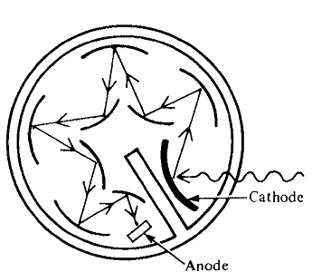
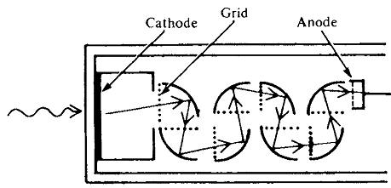
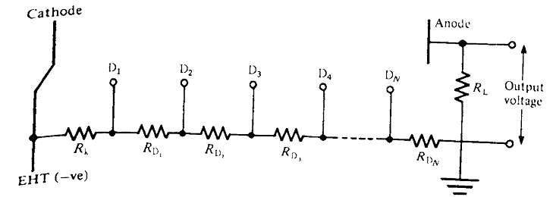


Photomultipliers
vacuum tube
large mean free path for the secundary electrons
+
+++
++
++
++
++
++
++
++
++
++
Dynodes (~ 100 V)

Slide 8
Semiconductor photonic detectors:
FOUR questions
1.
2.
3.
4.

Slide 9

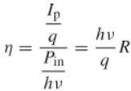
Responsivity and Quantum efficiency
1.
I_{p} = R P_{in}
R =
η (quantum efficiency of the detector) =
ratio of the number of hole–electron pairs generated to the number of incident photons
η
R
and
are correlated!

Slide 10
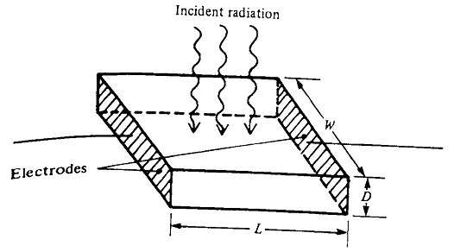



Responsivity and Quantum efficiency
- not all incident photons produce electron-hole pairs because some photons fail to be absorbed because of the probabilistic nature of the absorption process
P_{in}
w
α
- other photons may be reflected at the surface of the detector
P_{tr}

Slide 11

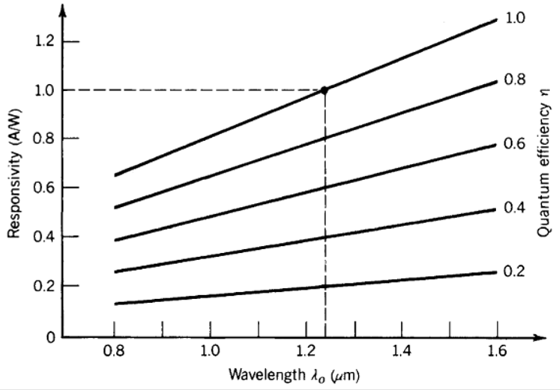
Spectral response
2.

Slide 12
Detectivity
3.
- The signal-to-noise (S/N) ratio indicates the amplitude of the signals compared to noise current (or voltage)
- If the S/N increases, the quality of the detected signal increases
- This corresponds to a high detectivity and a low noise equivalent power (NEP)
(we will study them in details in the section dedicated to the UV and IR detectors)

Slide 13
Detectivity
NEP:
the signal power that gives a signal-to-noise ratio of one in a fixed output bandwidth (1 Hz)
[W]
low NEP
high sensitivity
sensitivity: ability to detect low-level optical signals
Detectivity:
D = 1/NEP
[W⁻¹]

Slide 14
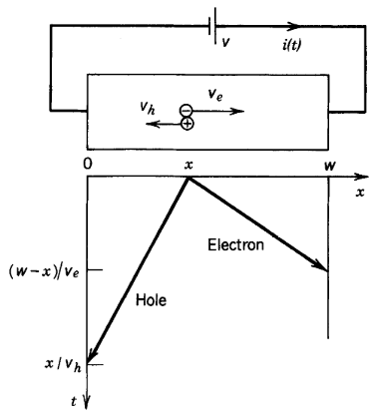
Time response
4.
- transit-time spread
- RC time-limited
response
- fixed gain-bandwidth product

Slide 15
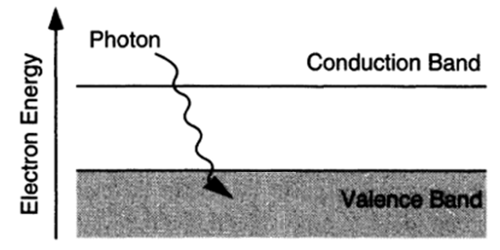
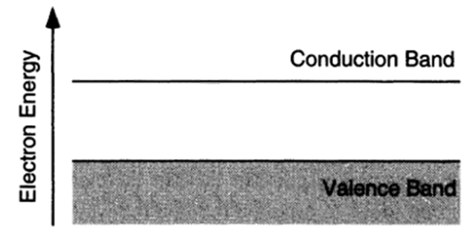
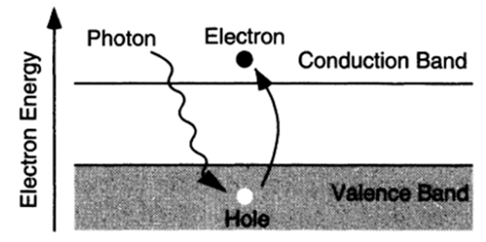


Photoconductive detectors
if ν too high,
absorption occurs
in a small layer
poor efficiency
the conductivity increases
photoconductivity
(as long as the electron remains in the conduction band...)

Slide 16






Photoconductive detectors: gain
If
G = τ / t_{r}
gain
τ depends upon the material (defects, quality...)
t_{tr} depends on the distance between the electrodes
and
Drawbacks:
high responsivity can be obtained only with slow
response times
random recombination process generates noise
then

Slide 17
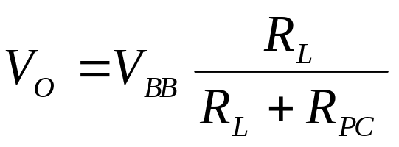
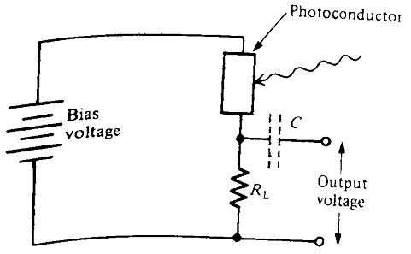
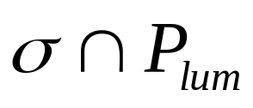
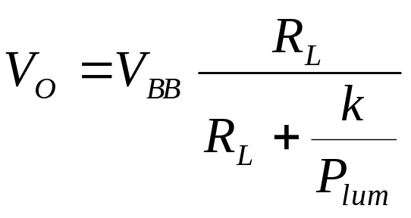
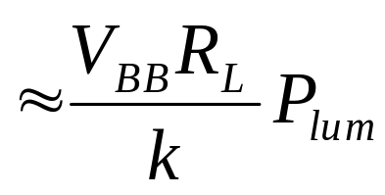
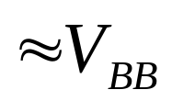
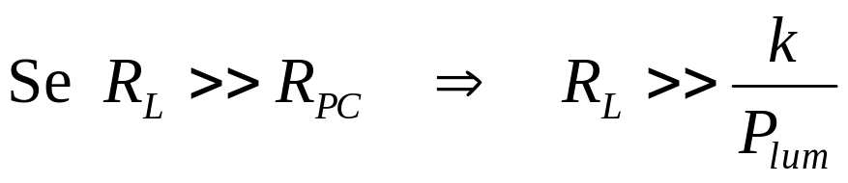
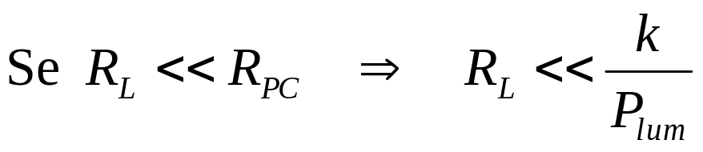
Photoconductive detectors: application circuits
just if interested to
the variations of
radiant intensity
Photoconductivity measurement
needs an external bias circuitry
R_{PC}
V_{BB}
poor sensitivity! (low R_{PC})
small output voltage! (low R_{L})

Slide 18
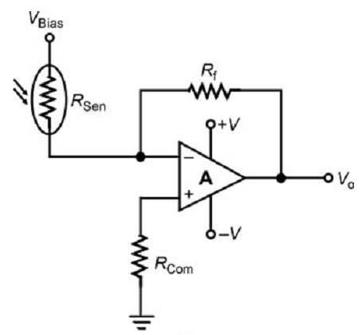



Photoconductive detectors : application circuits

Slide 19
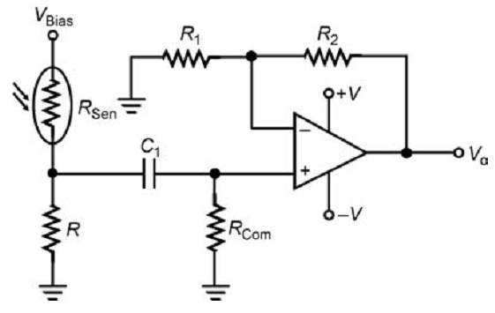
Photoconductive detectors : application circuits
The most common method used to extract the
signal is
to modulate the incident radiation at a specific frequency
by placing a mechanical chopper in front of the sensor
or by electrically modulating the radiation source
?????????????????????????????
either
The signal due to radiation is now an AC signal while the dark current is a DC signal.
The AC signal can be separated from the DC background signal using an AC amplifier
voltage mode amplifier

Slide 20
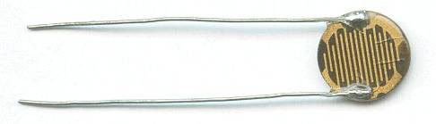

Fotoresistors (LDR)
Large surface
Close electrodes

Slide 21
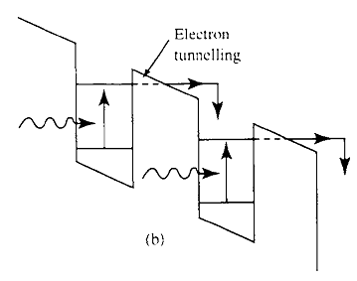
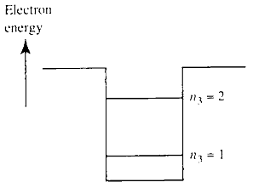
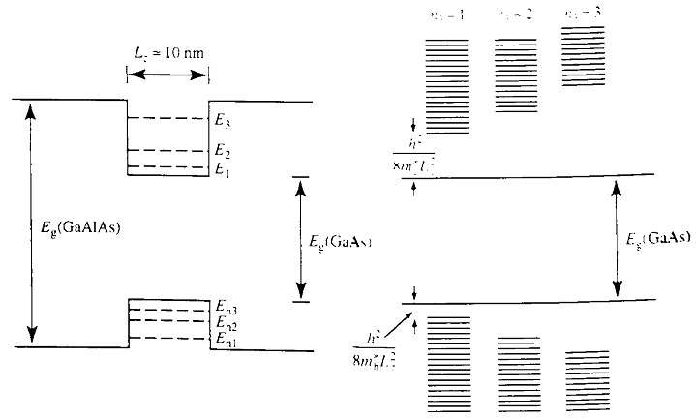

Multiple-quantum well (MQW) detectors

Slide 22
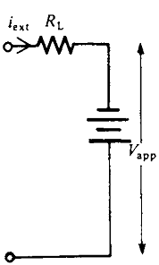
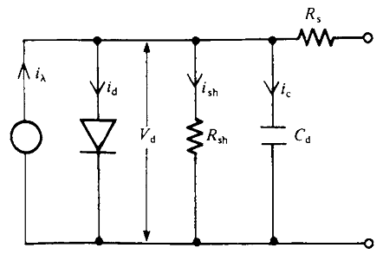
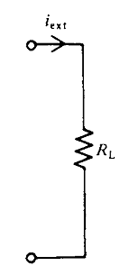
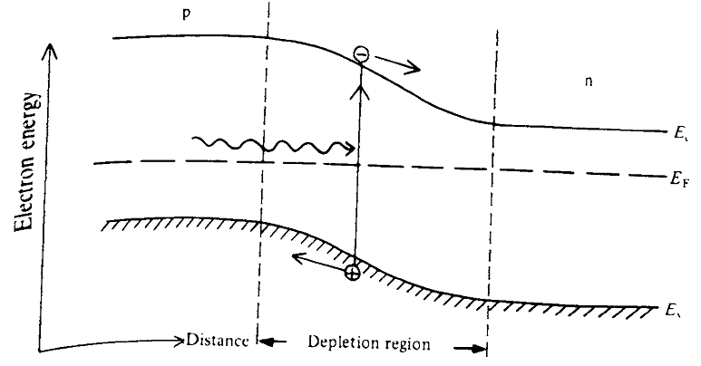

p-n junction detector (photodiode)
photovoltaic mode
photoconductive mode
i_{λ}
I₀
I₀ light irradiance falling on a cell of area A
(P₀ = I₀A)

Slide 23
Silicon photodiode
or…

Slide 24

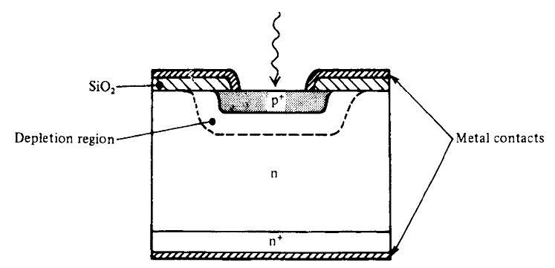
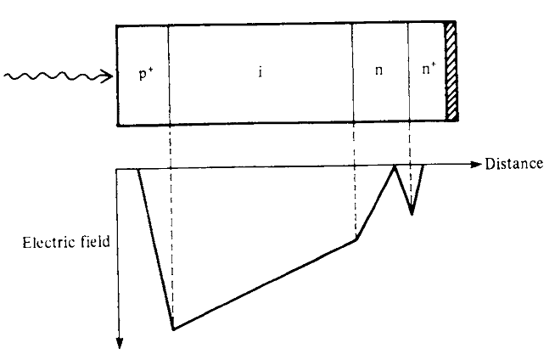
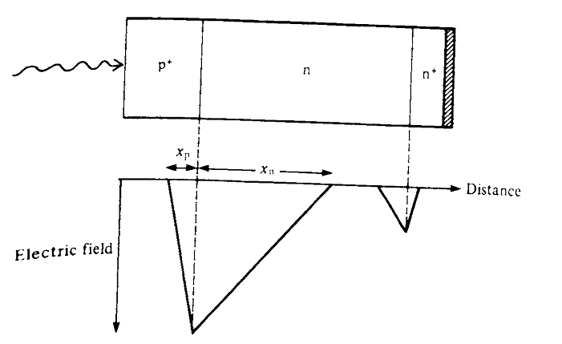
Silicon photodiode

Slide 25
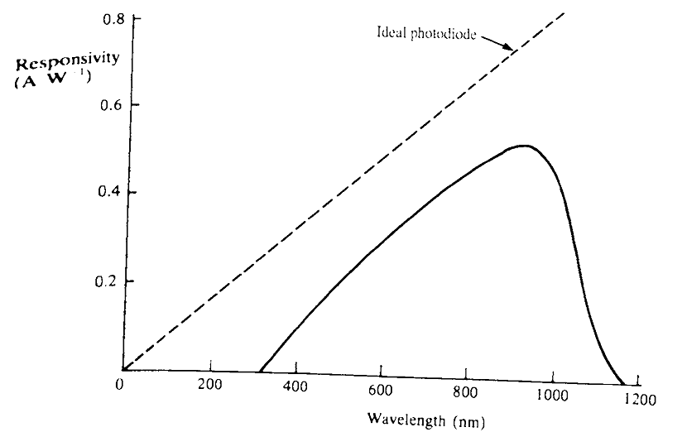
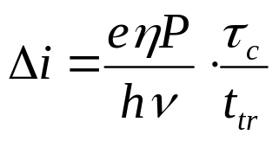
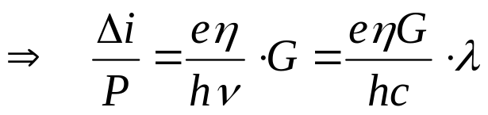
Silicon photodiode: responsivity

Slide 26
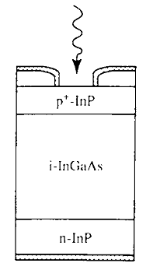

Photodiode materials (near IR)
Ge λ_{G} = 1.88 μm
In_{x}Ga_{1-x}As
(x = 0.53)
λ_{G} = 1.68 μm
lattice matched to InP
wider
bandgap
with narrow bandgap materials:
Why not homojunctions?
- low breakdown voltages
- large reverse leakage current

Slide 27
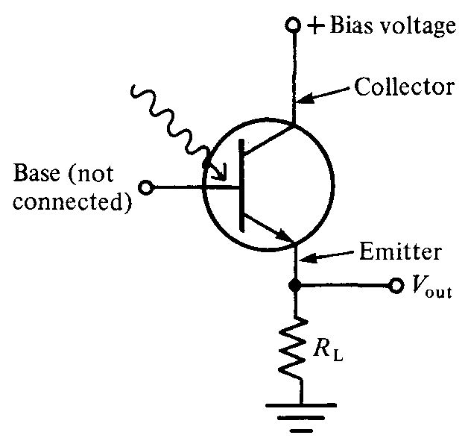
Phototransistors
V_{CB} < 0
Higher sensitivity (mA)
but…
I_{B}
less velocity
(μs vs. ns of photodiodes)
I_{E} = β I_{B}

Slide 28



Avalanche photodetectors (APD)
The guard ring structure is a low doping region where depletion region
extends an appreciable distance into it
In the vicinity of guard ring the total depletion layer is greater (hence the
maximum electric field is lower) than in the central region
reduced breakdown
no current leakage from the edge

Slide 29


Charge-Coupled Devices
(CCD)

Slide 30


Charge-Coupled Devices
(CCD)

Slide 31

Charge-Coupled Devices
(CCD)

Slide 32

CCD: read-out mechanisms

Slide 33


CCD: read-out mechanisms

